Slide 1


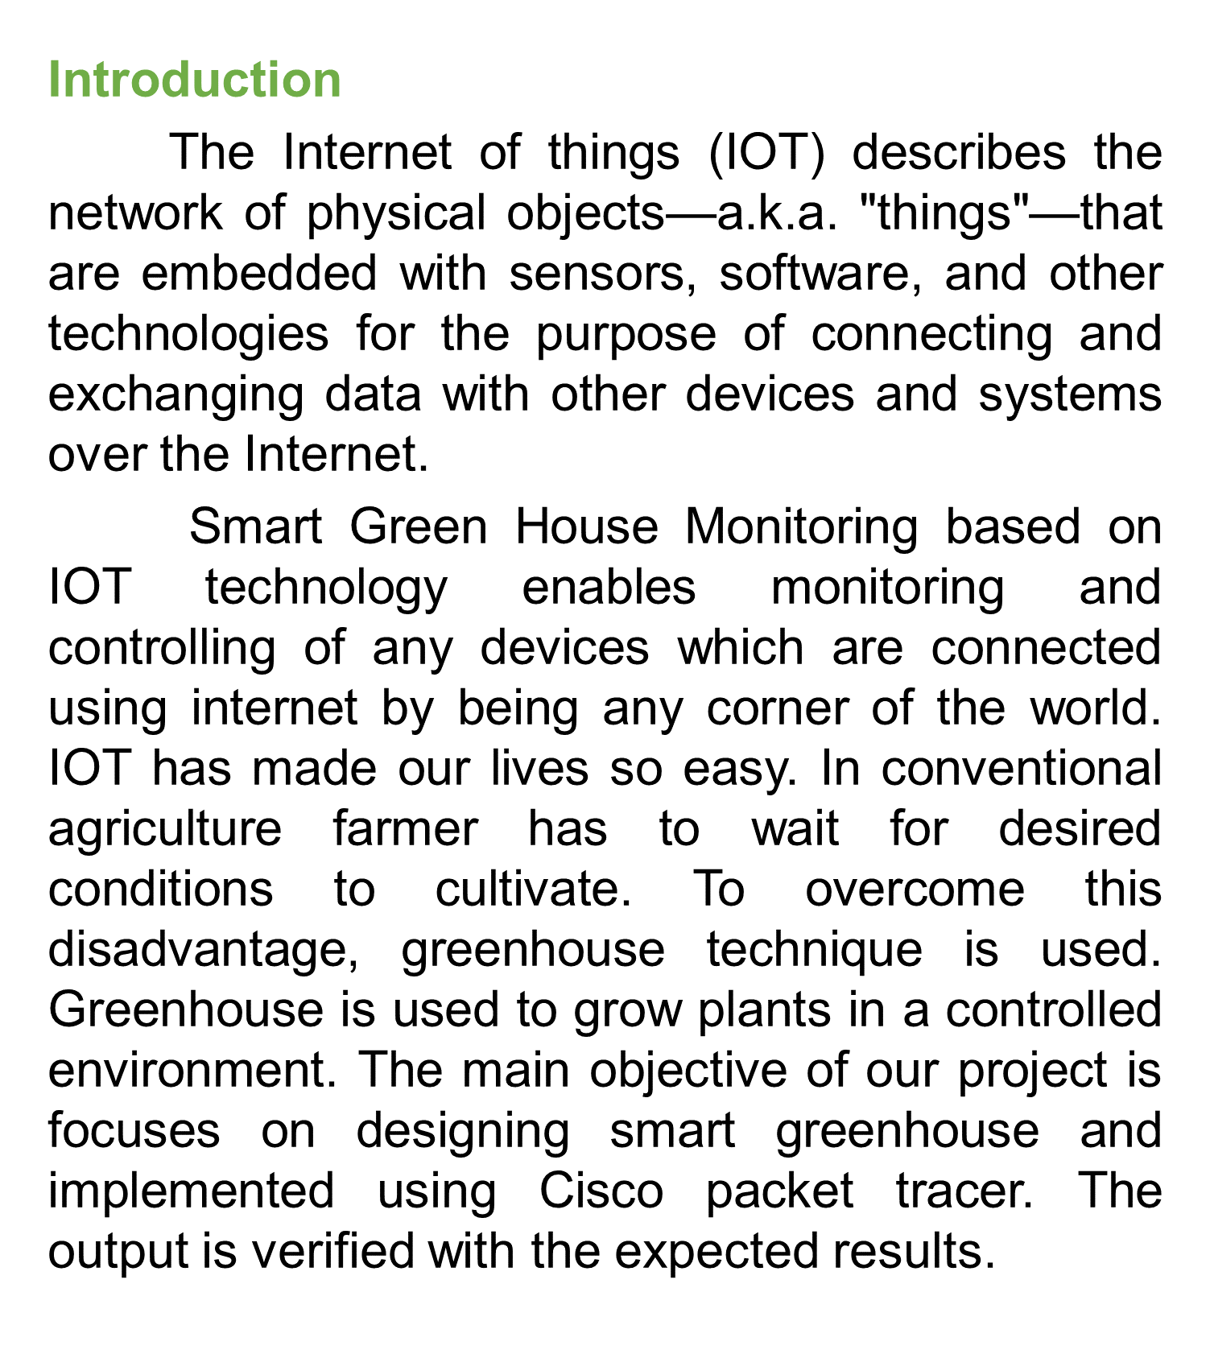
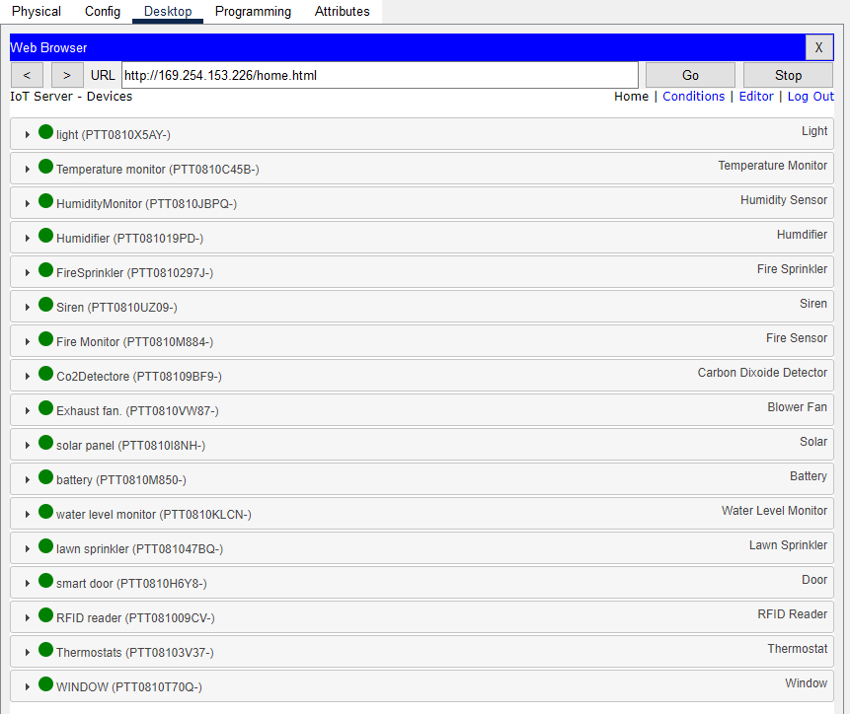
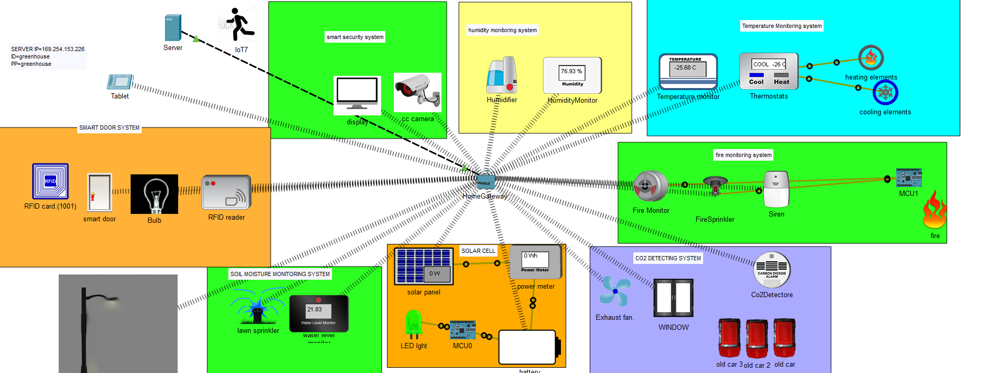
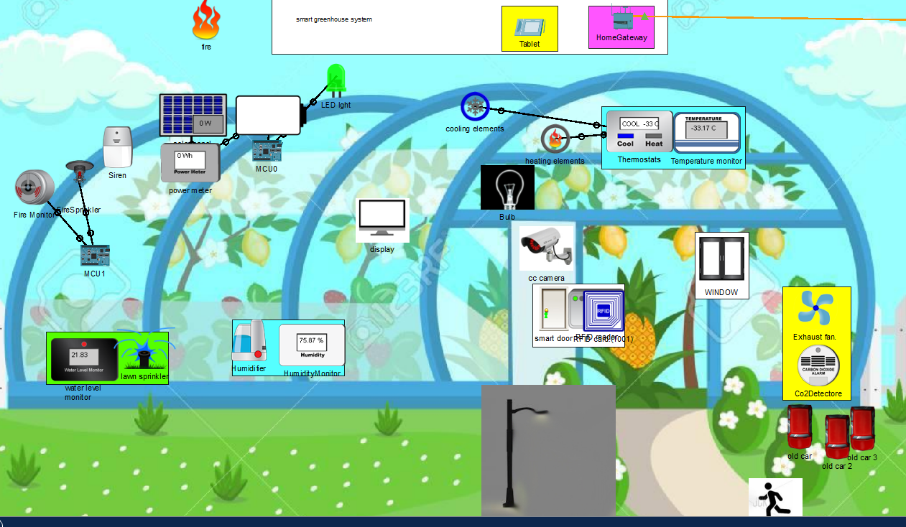
Rasaili Tilak, Neupane SanjayRaj, Gurung Kushal, Gurung Bibash, Lamichhane Biraj,Baseem Al-athwari, Ph.D. Department of Smart Computing, Kyungdong University
IMPLEMENTATION
In this project, we are implementing the greenhouse setup using cisco packet tracer. A network is formed by connecting the sensors and the information about the environmental parameters is stored in cloud.
IOT COMPONENTS
TEMPERATURE MONITORING SYSTEM
Temperature sensor keeps check on the temperature of the environment and displays the value.
B. HUMIDITY MONITORING SYSTEM
Humidity monitoring system contains humidity sensors, humidifiers. Humidifier is activated when the humidity percentage in the greenhouse falls below the desired value.
C. FIRE SAFETY SYSTEM
Fire detection system contains fire detector, fire sprinkler, siren As soon as the fire is detected message is delivered to the security panel and fire alarm is activated and then sprinkler too.
D. CO2 DETECTING SYSTEM
Carbon dioxide detector is a device which senses the concentration of carbon dioxide in the atmosphere. When carbon dioxide level will be high then fan will on and window will open.
E. SMART LIGHT SYSTEM
Smart lighting system is implemented by the sensor inbuilt in the smart light it will be activated.
F. SOIL MOISTURE MONITORING SYSTEM
Soil moisture monitoring system contains water level monitor, lawn sprinkler. Particular amount of moisture content falls below the preset value water sprinkler is activated.
G. SOLAR CELL
Solar cell contains solar panel, power meter, battery. A solar panel converts sunlight into electricity by using the appropriate technique.
H. SMART DOOR SYSTEM
Smart door system contains smart door, RFID reader, RFID card. RFID (Radio frequency identification) reader is used to read the RFID card given to the maintainers. Smart door opens only when RFID reader status is valid.
I.SMART SECURITY SYSTEM
Smart security system contains cctv camera and display. When cctv camera will capture the motion it will show on display.
Logical View
Physcial View
Conclusion
Greenhouse is used a lot now a day to increase the productivity and grow plants in controlled environment. Making it smarter ease the work of maintainer as there is no need to monitor the environmental conditions manually. Sensors are used to sense and actuators are activated according to the predefined conditions. This project shows the basic idea of implementing the greenhouse to grow plants, crops. This project explains the basic sensors and devices required to maintain the green house conditions with electricity generation using solar energy, smart lighting and other monitoring systems.
Acknowledgment
We wish to give our deep sense of gratitude and heartful thanks to our project mentor Baseem Al-athwari, Ph.D. for being the constant source of encouragement from selection of topic to implementation and further.

